Slide 1
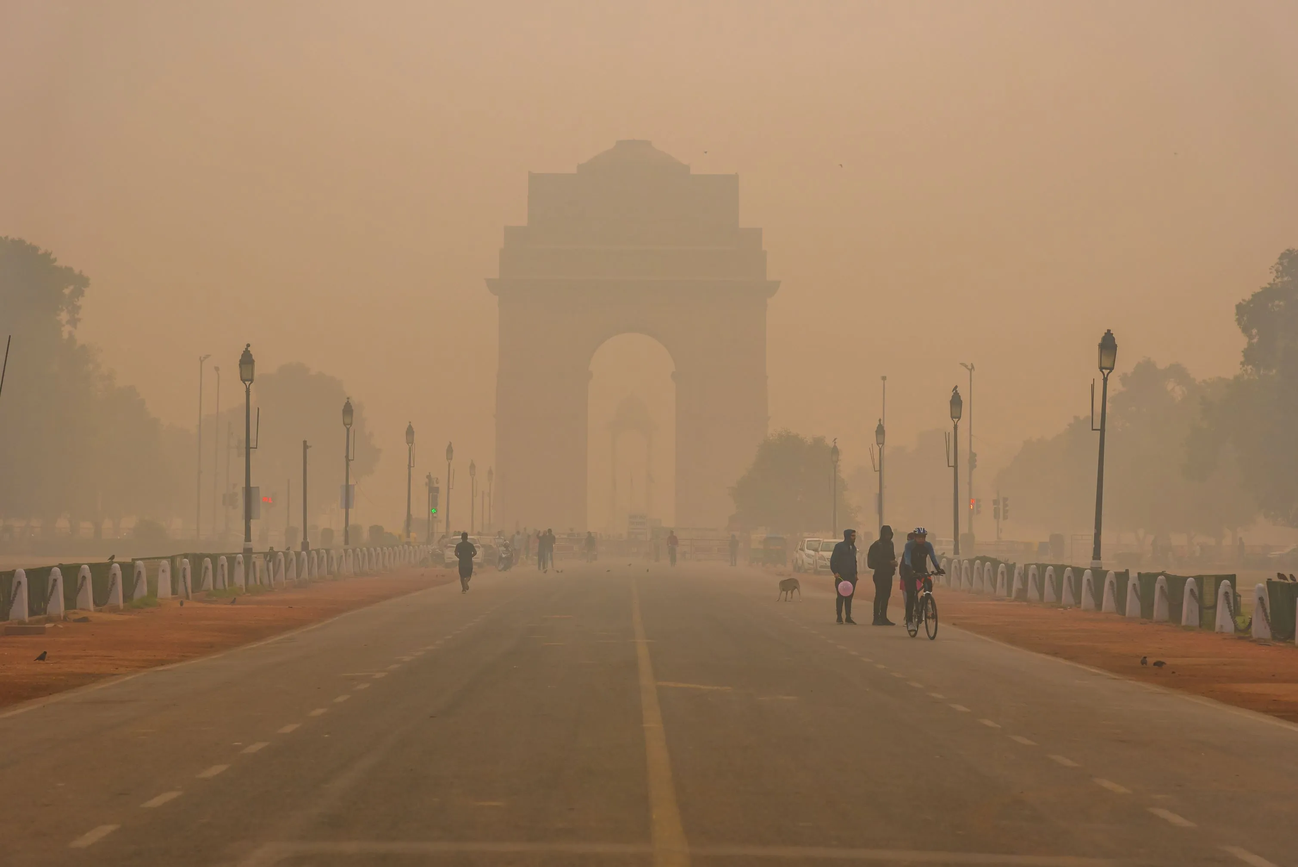
Air Quality -Driven Early Warning Health
Risk Prediction System
ALKA K S
Data Science

Slide 2
INTRODUCTION
Air pollution is a serious public health issue in metropolitan cities like Delhi
High levels of PM2.5 and PM10 are linked to respiratory and heart diseases
Traditional air quality reports provide current status only
They do not offer early risk prediction
This project introduces an ML-based early warning system
Helps support early awareness and preventive actions

Slide 3
PROBLEM STATEMENT
Existing air quality monitoring systems mainly report current or past pollution levels
They lack predictive capability based on cumulative exposure patterns
Alerts are often issued only after pollution reaches hazardous levels
This delays preventive action by individuals and public health authorities
There is a need for a data-driven system that can analyze historical trends
Such a system should predict potential high-risk exposure days in advance

Slide 4
OBJECTIVES
To analyze historical air quality data for Delhi (2015–2020).
To engineer time-series features representing cumulative pollution exposure.
To classify days into high-risk and normal-risk categories using machine learning.
To compare multiple ML models and select the most reliable one.
To develop a simple user interface for demonstrating health risk predictions.

Slide 5
Dataset Description
Dataset: Publicly available air quality dataset (2015–2020).
City: Delhi (single-city focus).
Source: Kaggle (compiled from CPCB, Government of India)
Key Pollutants:
PM2.5
PM10
NO₂
SO₂
CO
O₃

Slide 6
DATA PREPROCESSING
FEATURE ENGINEERING
RISK LABEL DEFINITION
Filtered dataset to include only Delhi city data.
Converted date column to datetime format and sorted chronologically.
Handled missing values using time-aware interpolation.
Selected relevant pollutant features.
Removed incomplete rows generated due to lag and rolling feature creation.
Lag Features:
PM2.5 and PM10 lagged by 1, 3, and 7 days.
Rolling Exposure Features:
3-day and 7-day moving averages for PM2.5 and PM10.
These features help model short-term exposure trends rather than single-day pollution spikes.
A binary target variable high_risk was created.
A day is labeled as high-risk if the 3-day average PM2.5 exceeds a defined threshold.
This approach reflects cumulative exposure impact instead of instantaneous pollution values.

Slide 7
Model Train
Problem formulated as binary classification (High-Risk vs Normal-Risk days)
Multiple models trained: Logistic Regression, Random Forest, XGBoost
Time-based train–test split used to avoid data leakage
Evaluation
Accuracy used for overall performance comparison
Recall prioritized to reduce missed high-risk days
Confusion matrix analyzed to track false negatives

Slide 8
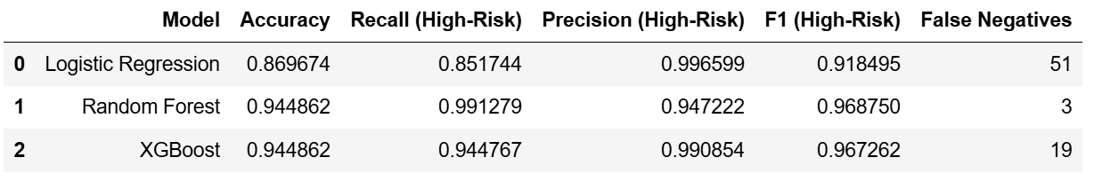
Model Comparison Table
Final Model Selection
Random Forest achieved highest recall and lowest false negatives
Selected for deployment due to stability and interpretability

Slide 9
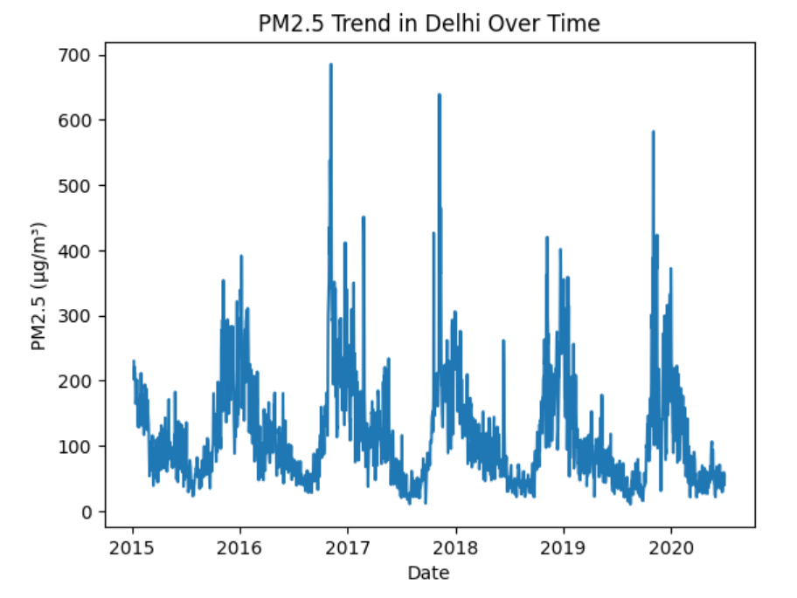
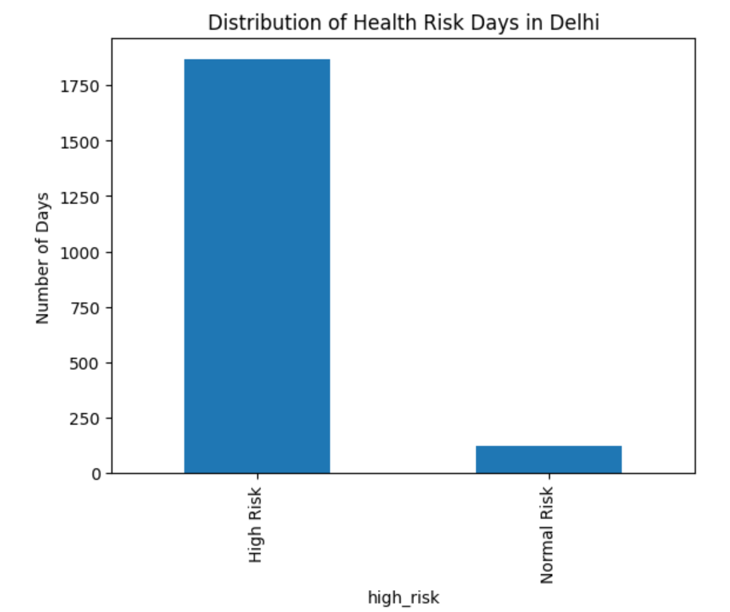
Graphical Overview

Slide 10
Process on Dataset
Air Quality Data
-->Data Preprocessing
-->Feature Engineering
-->Machine Learning Model
-->Risk Prediction (High / Normal)
-->User Interface(Gradio)

Slide 11
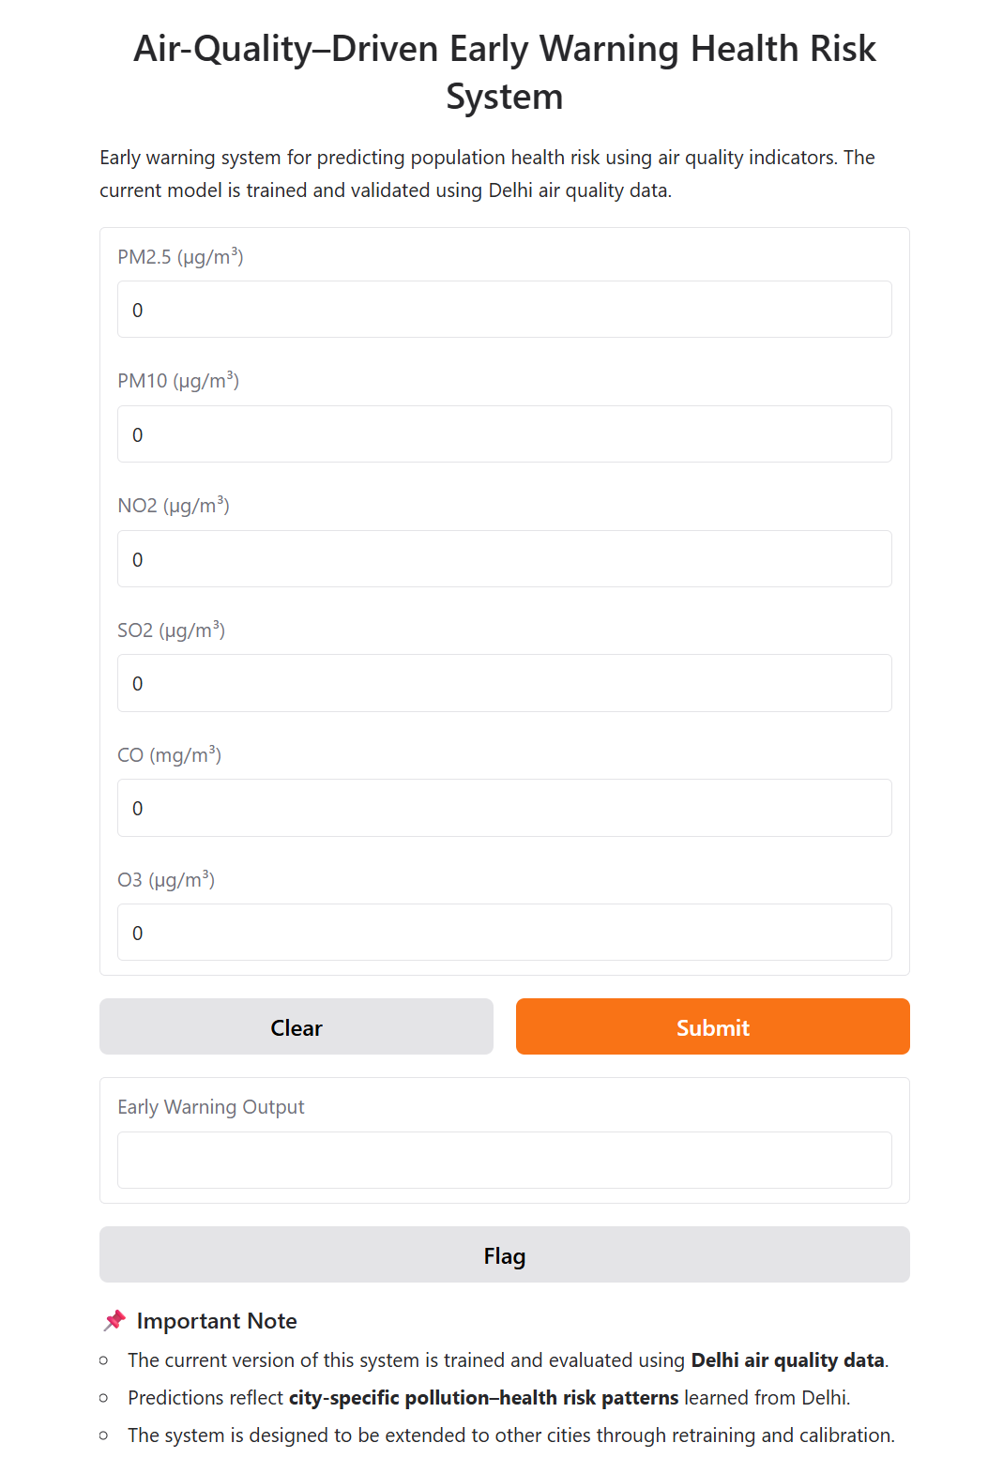
USER-INTERFACE

Slide 12
Limitations
The model is trained using air quality data from a single city (Delhi).
Predictions are based on historical pollution exposure and do not include direct medical data.
The system does not use real-time sensor inputs.
Health risk thresholds may vary across regions and populations.
The model provides decision support, not medical diagnosis.

Slide 13
FUTURE SCOPE
The system can support vulnerable groups such as asthma patients, elderly people, children, and individuals with heart or lung conditions by helping them take preventive precautions.
It can be extended as an early warning system, allowing people and institutions to act before health symptoms appear.
Health authorities and hospitals can use risk predictions for better preparedness, staffing, and issuing public advisories.
The model can be integrated into smart city platforms, mobile health applications, and public alert systems.
In the future, the system can be enhanced with next-day risk prediction, personalized alerts, and integration with wearable and location-based technologies.

Slide 14
CONCLUSION
Machine learning techniques were effectively used to analyze historical air quality data
The system successfully identified high-risk environmental exposure days
Time-series feature engineering improved risk pattern detection
Recall-focused evaluation ensured reliable identification of high-risk cases
The early warning framework supports preventive healthcare and public awareness
The project provides a strong foundation for future environmental health risk prediction systems

Slide 15
REFERENCE
Central Pollution Control Board (CPCB), Government of India
Air Quality Data in India (2015–2020)
Source: Kaggle
Dataset Link: https://www.kaggle.com/datasets/rohanrao/air-quality-data-in-india

Slide 16
THANK YOU

